Slide 1
Artificial Intelligence
1st Assignment
Juan Bellon, up201908142
Luísa Araújo, up201904996
Nuno Melo, up202003324

Slide 2
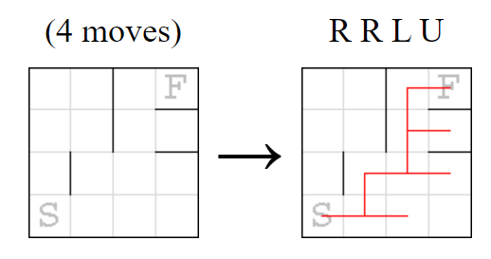
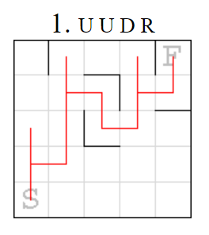
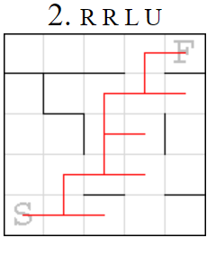
Robot Mazes
Single player game.
Main goal: Find the shortest sequence of necessary moves to reach the exit.
From the departure point until the exit the robot is going to follow every move of the sequence in a cycle.
If the robot bumps into a wall it does not move and passes to the next instruction (operator) of the sequence.
Example:

Slide 3
Formulation as a search problem (Part 1)
State Representation:
StartPosition = (xStart,yStart)
GoalPosition = (xGoal,yGoal)
Maze represented as a 2D array (Lines x Columns). Each element of the array represents another array. Elem = [u, d, l, r] where each index represents a boolean that indicates if there is a wall or not in that cell (example: maze(1,3) = [1,0,0,1])
RobotPosition = (xRobot, yRobot)
sequenceSize -> Represents the length of the, so far, generated sequence.
Initial State: RobotPosition = StartPosition
Objective Test: RobotPosition = GoalPosition
Heuristic Functions: Manhattan, Euclidean and Chebyshev distances.
5. Cost: Length of the sequence of moves.

Slide 4
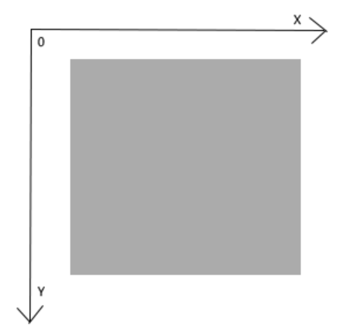
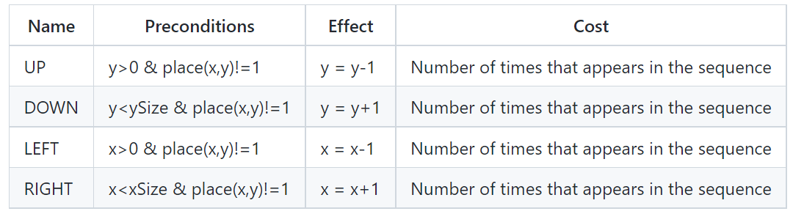
Formulation as a search problem (Part 2)
Operators:
Let’s assume xSize and ySize are the labyrinth’s dimensions.
Considering the xy axis has its origin in the superior left corner.

Slide 5
Implementation
Programming language: Python.
Development Environment: Visual Studio Code and Pycharm.
Main Libraries: Pygame for the graphical interface, Time and MatPlotLib for the experimental results, IterTools for generating sequences.
Data Structures:
Maze - Three dimensions array, for example: [[[1,0,0,1],[1,0,1,1]],[[1,0,0,1],[1,1,0,1]]]
Robot, start and goal positions as arrays, for example: (x,y) = [1,0]
For storing the generated sequences, a list is used as a queue (FIFO – first in first out)

Slide 6
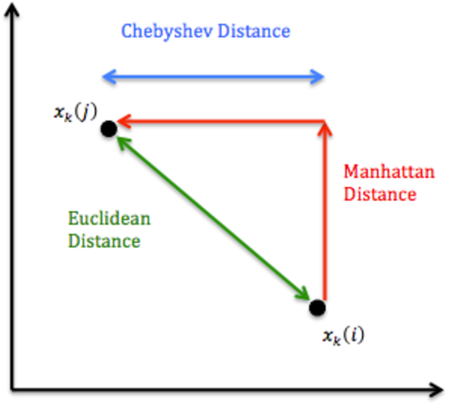
Approach
Heuristics:
Manhattan distance
manDist = dist(final, robot) = | xFinal – xRobot | + | yFinal – yRobot |
Euclidian distance
eucDist = dist(final, robot) = √((xFinal - xRobot)²+(yFinal – yRobot)²
Shebyshev distance
shebyDist = dist(final, robot) = max(| xFinal – xRobot |, | yFinal – yRobot |)

Slide 7
Implemented Algorithms
Breadth-First Search – Nodes at lowest depth are expanded first.
Depth-First Search – Always expand one of the deepest nodes in the tree.
Greedy Algorithm – Expands the node that appears (according to a heuristic) the closest to the solution.
A* (A-Star) – Combines the greedy with UCS (uniform cost search) minimizing the sum of the path already carried out with the minimum expected until the solution (cost + heuristic).
Note: At first, Uniform Cost Search was implemented but later deleted, since when the cost is equal to the depth of the node, Depth-First Search is the same as Uniform Cost Search, which is the case of this problem.

Slide 8
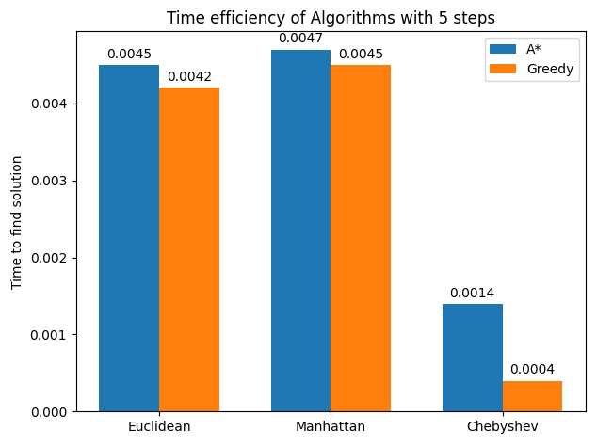
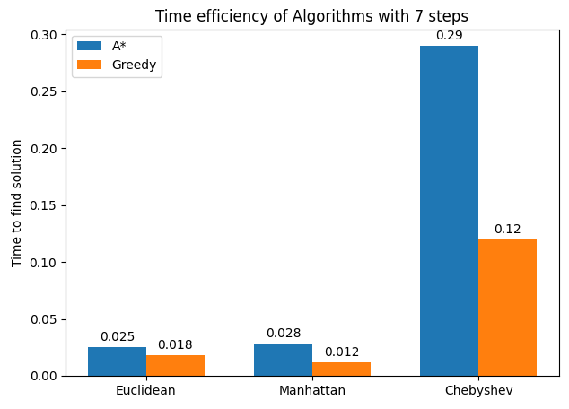
Experimental Results
Comparing heuristics
Note: Steps are moves in the sequence

Slide 9
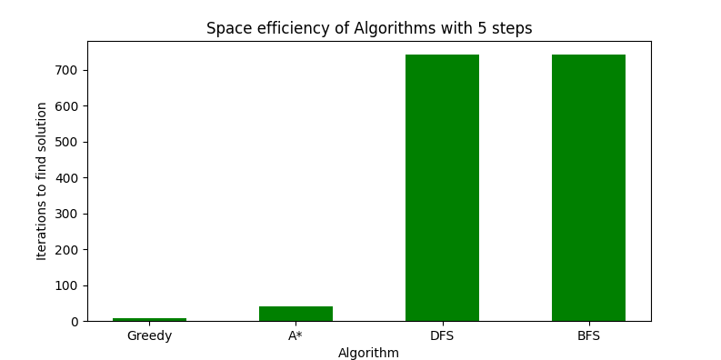
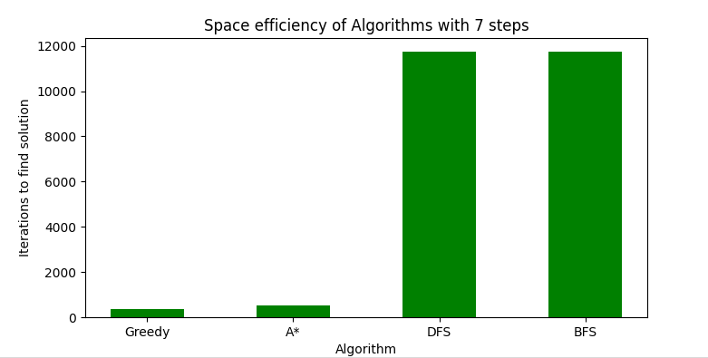
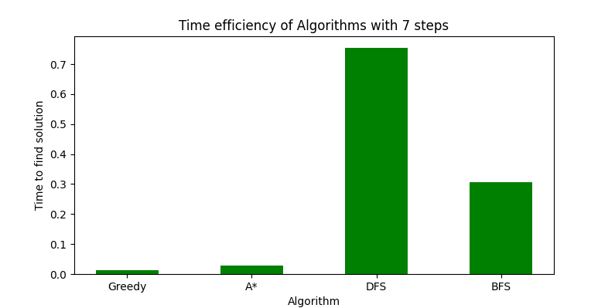
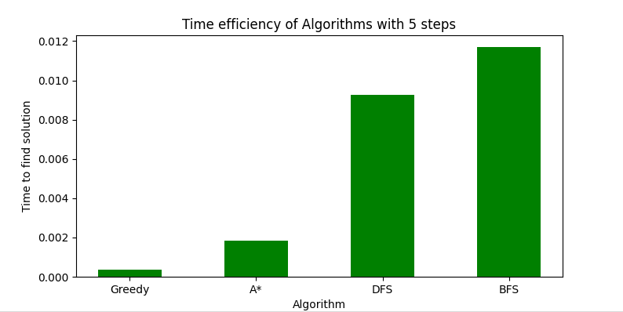
Experimental Results
Comparing algorithms

Slide 10
Conclusions
For the following conclusions we use execution time and space as evaluators. The faster the program (or algorithms), the better.
Heuristic Functions conclusions: When testing and comparing heuristics, two different mazes were used. These had different solution’s (sequences) sizes: 5 and 7. For the shorter solution, Chebyshev distance worked better than the others and even though the difference between Euclidean and Manhattan distance in this scenario weren’t as different, the Euclidean one still proved to be better. For the longer solution, Manhattan and Euclidean distance worked much better than the Chebyshev distance, being Manhattan distance the best heuristic, for both algorithms (A* and greedy).
Search Methods conclusions: As expected, BFS and DFS were the worst algorithms when it comes to the mentioned evaluators. Still, time-wise BFS proved to be significantly better than DFS for longer sequences (7) and worse than DFS for shorter sequences (5). Overall, greedy obtained the best results in both sequences and according to both criteria (space and time). Even though A* is better than BFS and DFS, it’s a little bit worse than greedy in all scenarios.

Slide 11
References
Problem Mazes: https://erich-friedman.github.io/puzzle/robot/
Information about some Heuristics: https://www.omnicalculator.com/math/manhattan-distance
Pygame documentation: https://www.pygame.org/docs/
Search Methods:
https://www.geeksforgeeks.org/breadth-first-search-or-bfs-for-a-graph/
https://medium.com/@nicholas.w.swift/easy-a-star-pathfinding-7e6689c7f7b2
https://towardsdatascience.com/understanding-a-path-algorithms-and-implementation-with-python-4d8458d6ccc7
Overall search:
https://mat.uab.cat/~alseda/MasterOpt/AStar-Algorithm.pdf
http://bryukh.com/labyrinth-algorithms/

